Slide 1
A4 – Lesson 1: Introduction to Multimedia

Slide 2
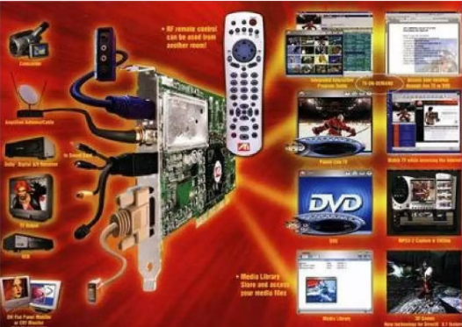

Slide 3

Today's lesson objectives
What is sound?
Compression algorithms
WAV, MP3 and MIDI formats
What is an image?
Image categories and their characteristics
Ways to capture video
Video characteristics and compression methods

Slide 4
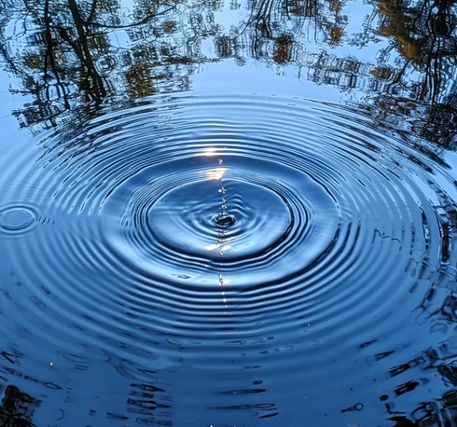
What is sound?
Sound is a wave (a continuous variation) in the pressure of air, water or another medium, which travels over a distance.

Slide 5
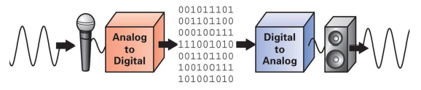
Digital sound and the sound digitisation process
Sound from the microphone is converted into an electrical signal.
It is sent to the Analogue-to-Digital Converter (ADC).
This converter takes samples (measurements) of the sound at a specific rate, called the sampling rate and measured in Hz.
Each sample (measurement) is then converted into a corresponding digital number, represented as a series of bits (usually 8 or 16 bits).

Slide 6
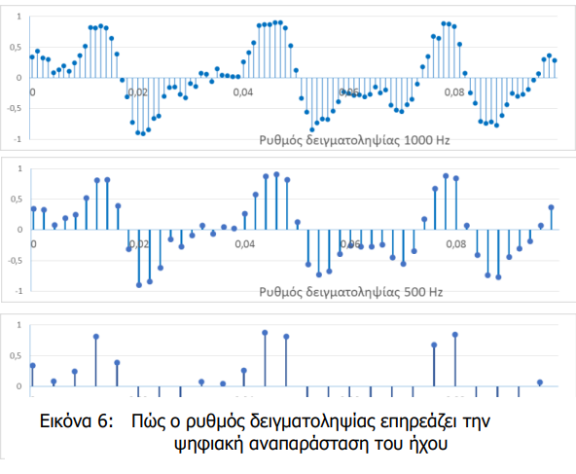
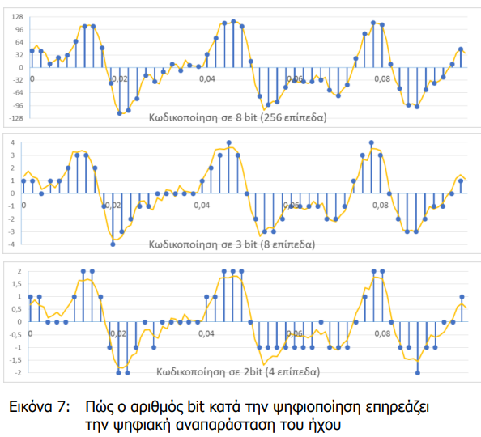
Key parameters of sound digitisation
The two key digitisation parameters used to represent each sound sample are:
The sampling rate (Hz)
The number of bits used to represent each sample
A higher sampling rate and more bits per sample produce a more accurate digital representation of sound. However, they also create more samples with more bits per sample, resulting in a larger amount of data.

Slide 7
Compression of digitised sound
Lossless or reversible compression algorithms
  They recover the original sound data without any loss (exactly the same bits).
Lossy or irreversible compression algorithms
  They remove sound characteristics that the human ear cannot perceive.
  They achieve even greater compression.

Slide 8
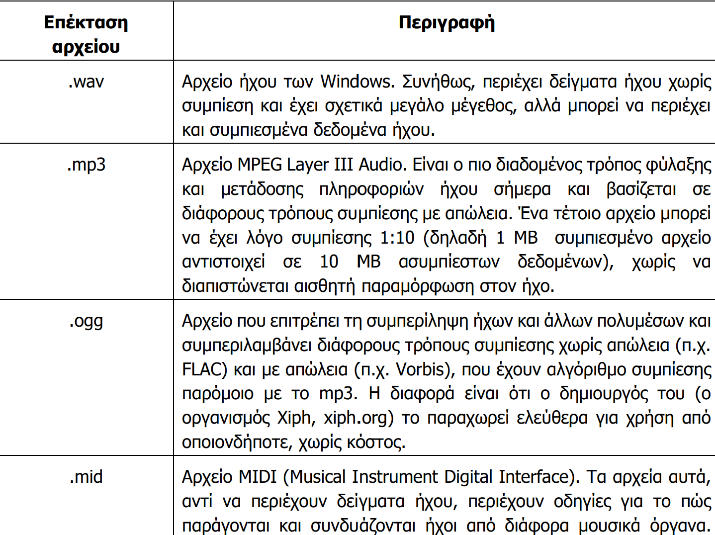
Digital audio formats

Slide 9
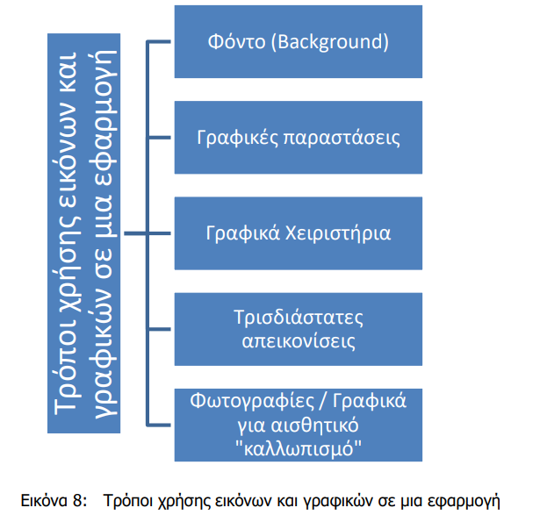
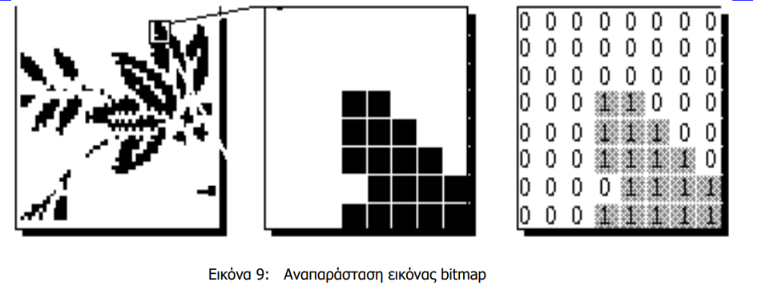
Image

Slide 10
Categories of digital images
Bitmap (raster) images
Vector images
  Elements are represented geometrically using lines, rectangles, ellipses or arcs.
  They have a smaller file size and can be processed faster by the computer.

Slide 11
Bitmap (raster) images
  They consist of picture elements (pixels or dots).
  Pixels combine to create a bitmap image in which each pixel has a value.
  In black-and-white images, a black pixel has the value 1, while a white pixel has the value 0.

Slide 12
Characteristics of a bitmap image
Resolution
  The number of picture elements (pixels or dots) per inch (ppi).
Colour depth
  The number of colours available for creating an image.
  1 bit gives 2¹ = 2 colours, 8 bits give 2⁸ = 256 colours, while 16 bits give 2¹⁶ = 65,536 colours
  Two colour models: RGB and CMYK
Size
  It depends on the dimensions, resolution and colour depth.

Slide 13
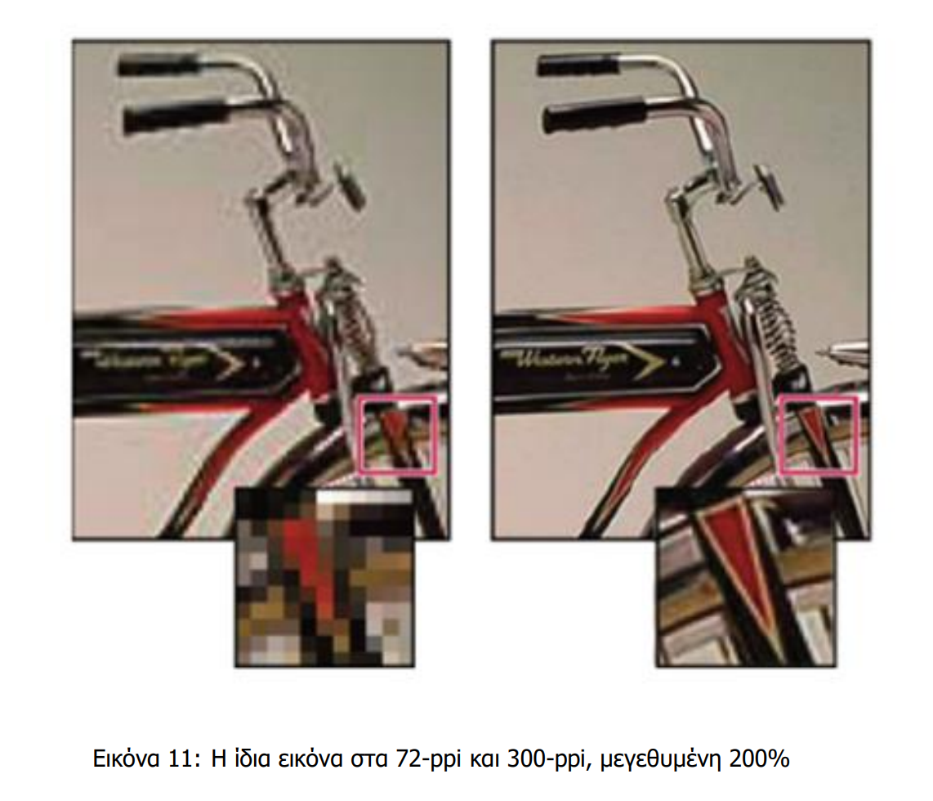
Characteristics of a bitmap image
Resolution

Slide 14
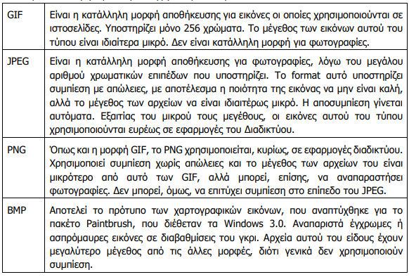
The best-known compression algorithms

Slide 15
What is video?
A video consists of many images of the same size placed one after another. They appear quickly enough to create the illusion of movement for the eye and brain.
https://www.youtube.com/watch?v=V8A4qudmsX0

Slide 16
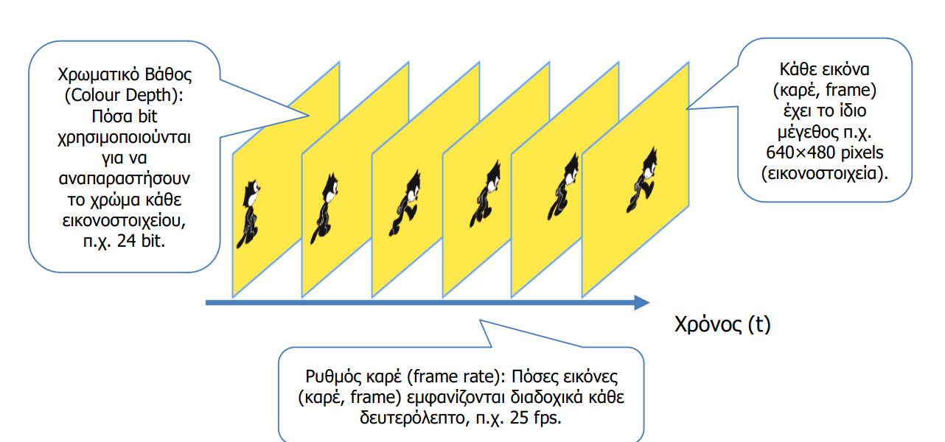
Main characteristics of video
How many frames does a 2-hour film have at 20 fps?

Slide 17
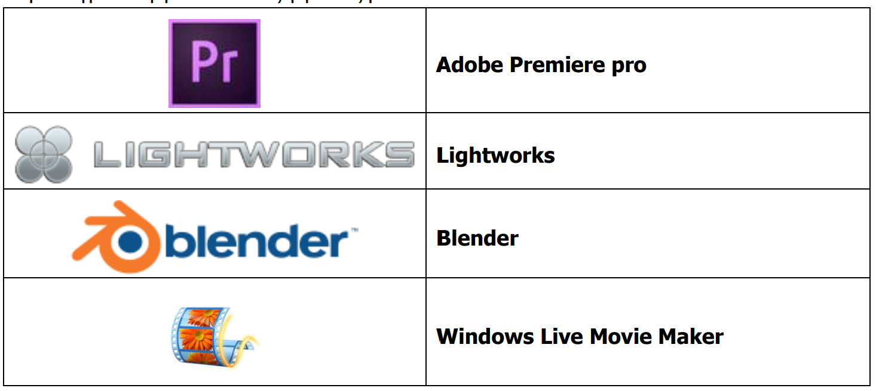
Digital video editing
Removing unnecessary shots or video sections
Adding new frames
Combining and editing different video files
Adding transitions between shots
Adding special effects
Adding music, sound effects and subtitles
Adjusting and synchronising audio and video

Slide 18
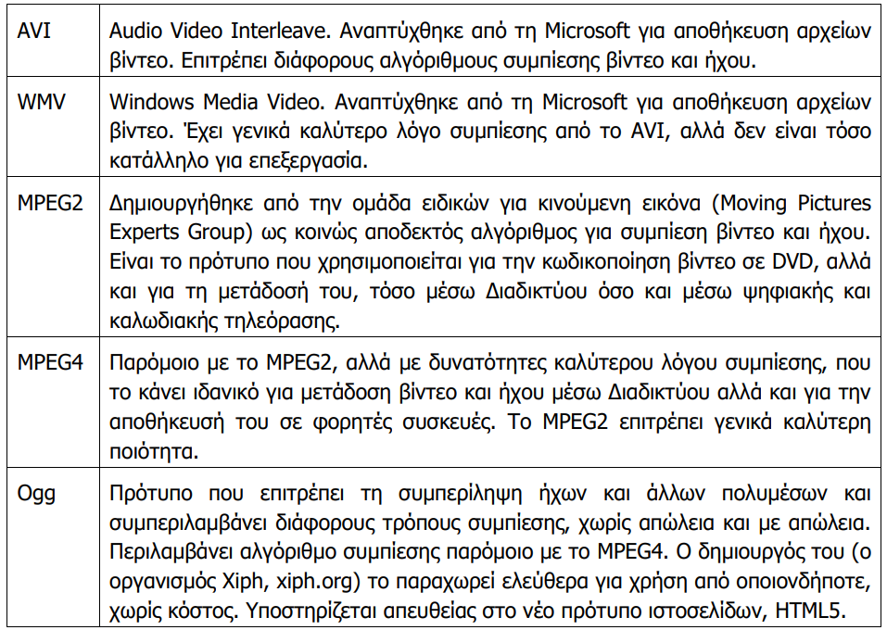
Video compression

Slide 19

Exercises
In class (Notes, pages 51–66)
1, 2, 3, 4 (pages 45–46)
A4.1.ï1_Quiz.htm

